Slide 1
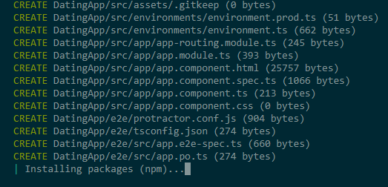
01 Walking Skeleton
(Check Pre-requisite) Open folder with vs.code,
> node –version
> npm –version
> ng –version (If not installed, npm install -g @angular/cli)
> tsc –version (If not installed, npm i -g typescript)
(Create Workspace) using ng cli
> ng new DatingApp (A couple of questions will be asked… then it will be created with npm installation)
(Test)
> ng serve –open (At first compilation, it takes some time. It opened the browser)
(Overview structure)
Ref: https://angular.io/guide/file-structure
2. Go to angular.json file and find "architect" name. Under that folder, we can get to know starting point: "index.html" and "main.ts"
3. "main.ts" points to "environment.ts" where web api end point is defined
4. "main.ts" points to "app.module.ts" where all modules are defined
5. review all structure of "app.module.ts"
(Test Component)
> cd \DatingApp-SPA\src\app
> ng g c value
app.component.html (overwrite)
<!--The content below is only a placeholder and can be replaced.-->
<div>
<h1>
Dating App
</h1>
<app-value></app-value>
</div>
value.component.ts (overwrite)
import { Component, OnInit } from '@angular/core';
import { HttpClient } from '@angular/common/http';
@Component({
selector: 'app-value',
templateUrl: './value.component.html',
styleUrls: ['./value.component.css']
})
export class ValueComponent implements OnInit {
values: any;
constructor(private http: HttpClient) { }
ngOnInit() {
this.getValues();
}
getValues() {
this.http.get('http://localhost:5000/api/values').subscribe(response => {
this.values = response;
}, error => {
console.log(error);
});
}
}

Slide 2
5. value.component.html (overwrite)
<p *ngFor="let value of values">
{{value.id}}, {{value.name}}
</p>
6. app.module.ts
…
import {HttpClientModule} from '@angular/common/http’;
…
imports: [
BrowserModule,
AppRoutingModule,
HttpClientModule
],
(Test)
7. http://localhost:4200/
(NOTE: BE server should be running at first)
02 Security
(Add Navigation)
1. >npm i bootstrap
2. >npm I font-awesome
3. >cd src/app
4. src/app>ng g c nav
5. nav.component.html
<nav class="navbar navbar-expand-md navbar-dark bg-dark">
<a class="navbar-brand" href="#">Dating App</a>
<ul class="navbar-nav mr-auto">
<li class="nav-item active">
<a class="nav-link" href="#">Matches</a>
</li>
<li class="nav-item">
<a class="nav-link" href="#">Lists</a>
</li>
<li class="nav-item">
<a class="nav-link" href="#">Messages</a>
</li>
<li class="nav-item">
<a class="nav-link" (click)="logout()">Logout</a>
</li>
</ul> <div *ngIf="loggedIn()" class="dropdown">
<a class="dropdown-toggle text-light">
Welcome User
</a>
<div class="dropdown-menu">
<a class="dropdown-item" href="#"><i class="fa fa-user"></i> Edit Profile</a>
<div class="dropdown-divider"></div>
<a class="dropdown-item" href="#"><i class="fa fa-sign-out"></i> Logout</a>
</div>
</div> <!-- app.module : FormsModule should be registered in order to ngForm -->
<form *ngIf="!loggedIn()" #loginForm="ngForm" class="form-inline my-2 my-lg-0" (ngSubmit)="login()">
<input class="form-control mr-sm-2" type="text" name="username"
placeholder="Username" required [(ngModel)]="model.username">
<input class="form-control mr-sm-2" type="password" name="password"
placeholder="Password" required [(ngModel)]="model.password">
<button [disabled]="!loginForm.valid" class="btn btn-success my-2 my-sm-0" type="submit">Login</button>
</form> <!-- Form state and field state: valid, touched and dirty : By doing this, we can get to know form.valid --> </nav>
Style.css
@import '../node_modules/bootstrap/dist/css/bootstrap.min.css';
@import '../node_modules/font-awesome/css/font-awesome.min.css';
App.module.ts
…
import {FormsModule} from '@angular/forms’;
…
imports: [
BrowserModule,
AppRoutingModule,
HttpClientModule,
FormsModule
],

Slide 3
6. nav.component.ts
import { Component, OnInit } from '@angular/core';
import { AuthService } from '../_services/auth.service';
@Component({
selector: 'app-nav',
templateUrl: './nav.component.html',
styleUrls: ['./nav.component.css']
})
export class NavComponent implements OnInit {
model: any = {};
// dependency injection
constructor(private authService: AuthService) { }
ngOnInit() {
}
// after successful login, please make sure token is saved in local storage
login() {
this.authService.login(this.model).subscribe(next => {
console.log('Logged in successfully');
}, error => {
console.log('Failed to login');
});
}
loggedIn() {
const token = localStorage.getItem('token');
return !!token; // !! means retrun true of false
}
logout() {
localStorage.removeItem('token');
console.log('logged out');
}
}
(Add Service)
1. \src\app> mkdir _services
2. src\app\_services>ng g service auth
3. auth.service.ts
import { Injectable } from '@angular/core';
import { HttpClient } from '@angular/common/http';
import { map } from 'rxjs/operators';
// Make sure it is registered in app.module
@Injectable({
providedIn: 'root'
})
export class AuthService {
baseUrl = 'http://localhost:5000/api/auth/';
// dependency injection
constructor(private http: HttpClient) {}
login(model: any) {
return this.http.post(this.baseUrl + 'login', model).pipe(
map((response: any) => {
const user = response;
if (user) {
localStorage.setItem('token', user.token); // save token to localstorage
}
})
);
} register(model: any) {
return this.http.post(this.baseUrl + 'register', model); // it returns observable
}
}
4. app.module.ts (NOTE: Service is not automatically registered)
…
import { AuthService } from './_services/auth.service’;
…
providers: [AuthService],

Slide 4
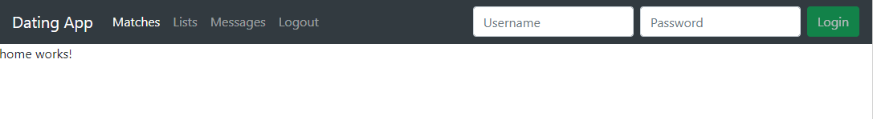
(Add Two more components)
src/app>ng g c home
src/app>ng g c register
(Modify Link)
app.component.html
<app-nav></app-nav>
<app-home></app-home>
(Test)
1. http://localhost:4200/
(Two Components Update)
1. home.component.html
<div class="container mt-5"> <!-- mt: margin top-->
<div *ngIf="!registerMode" style="text-align: center">
<h1>Find your match</h1>
<p class="lead">Come on in to view your matches... All you need to do is sign up!</p>
<div class="text-center">
<button class="btn btn-primary btn-lg mr-2" (click)="registerToggle()">Register</button>
<button class="btn btn-info btn-lg">Learn more</button>
</div>
</div>
<div *ngIf="registerMode" class="container">
<div class="row justify-content-center">
<div class="col-4">
<!-- how to communicate child component : child to parent -->
<app-register (cancelRegister)="cancelRegisterMode($event)"></app-register>
</div>
</div>
</div>
</div>
2. home.component.ts
import { Component, OnInit } from '@angular/core';
import { HttpClient } from '@angular/common/http';
@Component({
selector: 'app-home',
templateUrl: './home.component.html',
styleUrls: ['./home.component.css']
})
export class HomeComponent implements OnInit {
registerMode = false;
constructor(private http: HttpClient) { }
ngOnInit() {
}
registerToggle() {
this.registerMode = true;
}
cancelRegisterMode(registerMode: boolean) {
this.registerMode = registerMode;
}
}
3. Register.component.html
<form #registerForm="ngForm" (ngSubmit)="register()">
<h2 class="text-center text-primary">Sign Up</h2>
<hr>
<div class="form-group">
<input type="text" class="form-control" required name="username" [(ngModel)]="model.username" placeholder="Username">
</div>
…

Slide 5
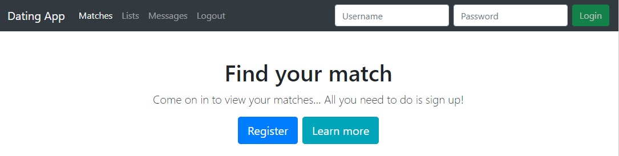
…
<div class="form-group">
<input type="password" class="form-control" required name="password" [(ngModel)]="model.password" placeholder="Password">
</div>
<div class="form-group text-center">
<button class="btn btn-success" type="submit">Register</button>
<button class="btn btn-default" type="button" (click)="cancel()">Cancel</button>
</div>
</form>
4. Register.component.ts
import { Component, OnInit, Input, Output, EventEmitter } from '@angular/core';
import { AuthService } from '../_services/auth.service';
@Component({
selector: 'app-register',
templateUrl: './register.component.html',
styleUrls: ['./register.component.css']
})
export class RegisterComponent implements OnInit {
@Output() cancelRegister = new EventEmitter(); // NOTE: it must be angular/core
model: any = {};
// Dependency Injection
constructor(private authService: AuthService) { }
ngOnInit() {
}
…
…
register() {
this.authService.register(this.model).subscribe(() => {
console.log('registration successful');
}, error => {
console.log(error);
});
}
cancel() {
// child to parent: raise event
this.cancelRegister.emit(false); // e.preventDefault();
console.log('cancelled');
}
}
(Test)
http://localhost:4200/
Login and Register Testing. When testing, raise some of error on purpose as well.
(no logout or user info yet. The output only shows developer console window at the moment)

Slide 6
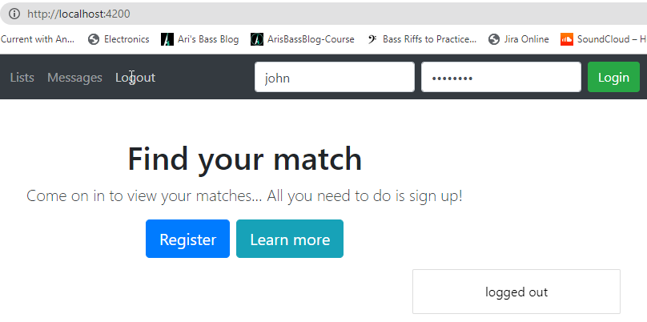
03 Third Party Component
(Alertify)
> npm install alertifyjs
Style.css
@import '../node_modules/bootstrap/dist/css/bootstrap.min.css';
@import '../node_modules/bootswatch/dist/united/bootstrap.min.css';
@import '../node_modules/font-awesome/css/font-awesome.min.css';
@import '../node_modules/alertifyjs/build/css/alertify.min.css';
@import '../node_modules/alertifyjs/build/css/themes/bootstrap.min.css’;
3. angular.json (add)
"scripts": ["node_modules/alertifyjs/build/alertify.min.js"]
4. > \src\app\_services>ng g s alertify
5. Register service to app.module
…
import { AlertifyService } from './_services/alertify.service’;
… providers: [AuthService,AlertifyService],
…
6. Apply alertify to nav.component.ts
constructor(private authService: AuthService, private alertify: AlertifyService) { }
…
login() {
this.authService.login(this.model).subscribe(next => {
// console.log('Logged in successfully');
this.alertify.success('Logged in successfully');
}, error => {
// console.log('Failed to login');
this.alertify.error(error);
});
}
…
logout() {
localStorage.removeItem('token');
// console.log('logged out');
this.alertify.message('logged out');
}
7. Apply alertify to register.component.ts
…
// Dependency Injection
constructor(private authService: AuthService, private alertify: AlertifyService) { }
…
register() {
this.authService.register(this.model).subscribe(() => {
// console.log('registration successful');
this.alertify.success('registration successful');
}, error => {
// console.log(error);
this.alertify.error(error);
});
}
…
8. Test
(Angular JWT)
(search for angular "2" JWT: For better checking JWT token)
1. > npm install @auth0/angular-jwt

Slide 7
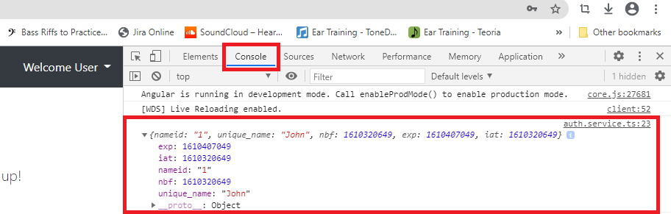
2. auth.service.ts
import { Injectable } from '@angular/core';
import { HttpClient } from '@angular/common/http';
import { map } from 'rxjs/operators';
import { JwtHelperService } from '@auth0/angular-jwt';
@Injectable({
providedIn: 'root'
})
export class AuthService {
baseUrl = 'http://localhost:5000/api/auth/';
jwtHelper = new JwtHelperService();
decodedToken: any;
constructor(private http: HttpClient) {}
login(model: any) {
return this.http.post(this.baseUrl + 'login', model).pipe(
map((response: any) => {
const user = response;
if (user) {
localStorage.setItem('token', user.token);
this.decodedToken = this.jwtHelper.decodeToken(user.token);
console.log(this.decodedToken);
}
})
);
}
register(model: any) {
return this.http.post(this.baseUrl + 'register', model);
}
loggedIn() {
let token:any = localStorage.getItem('token');
return !this.jwtHelper.isTokenExpired(token);
}
}
3. nav.component.ts
…
// NOTE: why public? because html need to access to this dependency injection (authService)
constructor(public authService: AuthService, private alertify: AlertifyService) { }
…
loggedIn() {
return this.authService.loggedIn();
}
…
4. Test
After login, we can check decoded token. The token itself can be confirmed in Application tab.
(NGX bootstrap)
npm install ngx-bootstrap
…
import { BrowserAnimationsModule } from '@angular/platform-browser/animations';
import { BsDropdownModule } from 'ngx-bootstrap/dropdown’;
…
imports: [
BrowserModule,
HttpClientModule,
FormsModule,
BrowserAnimationsModule,
BsDropdownModule.forRoot()
],

Slide 8
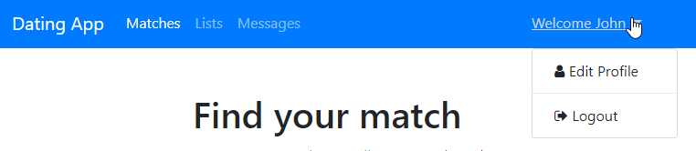
3. nav.component.html (rewrite)
<!-- bg-primary is related to bootswatch -->
<nav class="navbar navbar-expand-md navbar-dark bg-primary">
<div class="container">
<a class="navbar-brand" href="#">Dating App</a>
<ul *ngIf="loggedIn()" class="navbar-nav mr-auto">
<li class="nav-item active">
<a class="nav-link" href="#">Matches</a>
</li>
<li class="nav-item">
<a class="nav-link" href="#">Lists</a>
</li>
<li class="nav-item">
<a class="nav-link" href="#">Messages</a>
</li>
</ul> <div *ngIf="loggedIn()" class="dropdown" dropdown>
<a class="dropdown-toggle text-light" dropdownToggle>
Welcome {{ authService.decodedToken?.unique_name | titlecase }}
</a> <!-- the below comes from NGX bootstrap -->
<div class="dropdown-menu mt-3" *dropdownMenu>
<a class="dropdown-item" href="#">
<i class="fa fa-user"></i> Edit Profile</a>
<div class="dropdown-divider"></div>
<a class="dropdown-item" (click)="logout()">
<i class="fa fa-sign-out"></i> Logout</a>
</div>
</div>
<form *ngIf="!loggedIn()" #loginForm="ngForm" class="form-inline my-2 my-lg-0" (ngSubmit)="login()">
<input class="form-control mr-sm-2" type="text" name="username" placeholder="Username" required [(ngModel)]="model.username">
<input class="form-control mr-sm-2" type="password" name="password" placeholder="Password" required [(ngModel)]="model.password">
<button [disabled]="!loginForm.valid" class="btn btn-success my-2 my-sm-0" type="submit">Login</button>
</form>
</div>
</nav>
4. nav.component.css
.dropdown-toggle, .dropdown-item {
cursor: pointer;
}
5. Test
(Bootswatch)
> npm install bootswatch
Style.css
…
@import '../node_modules/bootswatch/dist/united/bootstrap.min.css’;
…

Slide 9
04 Routes
Create three components (as below). Note: member-list component should be under members folder
\scr\app>mkdir members
Cd members
\src\app\members>ng g c member-list
\src\app>ng g c lists
\src\app>ng g c messages
Create folder _guards under src\app
Create auth.guard.ts file under _guards folder : _guards>g guard auth –skipTests (It is not component. When asked which interface, just let them implements “CanActivate”)
import { Injectable } from '@angular/core';
import { CanActivate, Router } from '@angular/router';
import { AuthService } from '../_services/auth.service';
import { AlertifyService } from '../_services/alertify.service';
// CanActivate is about route protection
// use this on routes.ts
@Injectable({
providedIn: 'root' // we do not need to register it over app.module
})
export class AuthGuard implements CanActivate {
constructor(private authService: AuthService, private router: Router,
private alertify: AlertifyService) {}
// returing boolean is good enough
// c.f: canActivate returuns "union" type. Among them, just pick up boolean type
canActivate(): boolean {
if (this.authService.loggedIn()) {
return true;
}
this.alertify.error('You shall not pass!!!');
this.router.navigate(['/home']); // send back them to home
return false;
}
}
7. app-routing.module.ts (this file was originally created)
import { NgModule } from '@angular/core';
import { Routes, RouterModule } from '@angular/router';
import { HomeComponent } from './home/home.component';
import { ListsComponent } from './lists/lists.component';
import { MemberListComponent } from './member-list/member-list.component';
import { MessagesComponent } from './messages/messages.component';
import { AuthGuard } from './_guards/auth.guard';
const routes: Routes = [
// each routes are object
{path: '', component: HomeComponent}, // note: if it is 'home', then log in and open different tab, and type url such as localhost:4200/ it will throw an error. Therefore it should be empty
{
path: '', // e.g. localhost:4200/members means localhost:4200/ + empty + members. It must be like this. It is called "dummy" route
runGuardsAndResolvers: 'always',
canActivate: [AuthGuard], // AuthGuard should be created at first.
// in order to centralized authGuard for all components as below
children: [
{path: 'members', component: MemberListComponent},
{path: 'messages', component: MessagesComponent},
{path: 'lists', component: ListsComponent},
]
},
{path: '**', redirectTo: '', pathMatch: 'full'}, // ** means "else". NOTE: define it very last. Ordering is important
];
@NgModule({
imports: [RouterModule.forRoot(routes)],
exports: [RouterModule]
})
export class AppRoutingModule { }

Slide 10
8. nav.component.ts
(routing is injected “programmatically”)
import { Component, OnInit } from '@angular/core';
import { AuthService } from '../_services/auth.service';
import { AlertifyService } from '../_services/alertify.service';
import { Router } from '@angular/router';
@Component({
selector: 'app-nav',
templateUrl: './nav.component.html',
styleUrls: ['./nav.component.css']
})
export class NavComponent implements OnInit {
model: any = {};
constructor(public authService: AuthService, private alertify: AlertifyService,
private router: Router) { }
ngOnInit() {
} login() {
this.authService.login(this.model).subscribe(next => {
this.alertify.success('Logged in successfully');
}, error => {
this.alertify.error(error);
}, () => { // the right place: complete to redirect user
this.router.navigate(['/members']); // once login, redirect thme to "members" routing
});
}
loggedIn() {
const token = localStorage.getItem('token');
return !!token;
} logout() {
localStorage.removeItem('token');
this.alertify.message('logged out');
this.router.navigate(['/home']); // once login, redirect thme to "home" routing
} }
9. nav.component.html (Rewrite)
<nav class="navbar navbar-expand-md navbar-dark bg-primary">
<div class="container">
<a class="navbar-brand" [routerLink]="['/home']">Dating App</a>
<ul *ngIf="loggedIn()" class="navbar-nav mr-auto">
<li class="nav-item" routerLinkActive="active">
<a class="nav-link" [routerLink]="['/members']">Matches</a>
</li>
<li class="nav-item" routerLinkActive="active">
<a class="nav-link" [routerLink]="['/lists']">Lists</a>
</li>
<li class="nav-item" routerLinkActive="active">
<a class="nav-link" [routerLink]="['/messages']">Messages</a>
</li>
</ul>
<div *ngIf="loggedIn()" class="dropdown" dropdown>
<a class="dropdown-toggle text-light" dropdownToggle>
Welcome {{authService.decodedToken?.unique_name | titlecase}}
</a>
<div class="dropdown-menu mt-3" *dropdownMenu>
<a class="dropdown-item" href="#">
<i class="fa fa-user"></i> Edit Profile</a>
<div class="dropdown-divider"></div>
<a class="dropdown-item" (click)="logout()">
<i class="fa fa-sign-out"></i> Logout</a>
</div>
</div>
<form *ngIf="!loggedIn()" #loginForm="ngForm" class="form-inline my-2 my-lg-0" (ngSubmit)="login()">
<input class="form-control mr-sm-2" type="text" name="username" placeholder="Username" required [(ngModel)]="model.username">
<input class="form-control mr-sm-2" type="password" name="password" placeholder="Password" required [(ngModel)]="model.password">
<button [disabled]="!loginForm.valid" class="btn btn-success my-2 my-sm-0" type="submit">Login</button>
</form>
</div>
</nav>

Slide 11
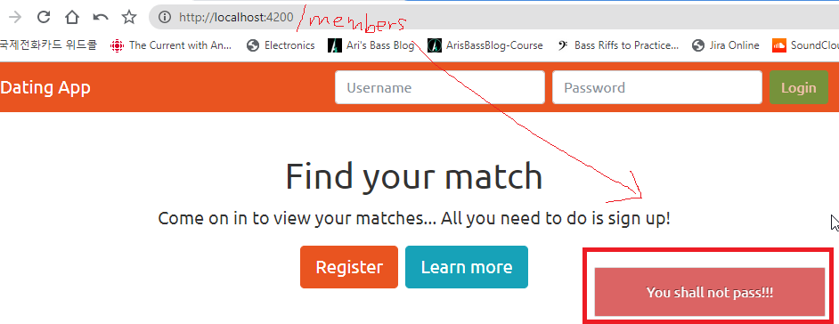
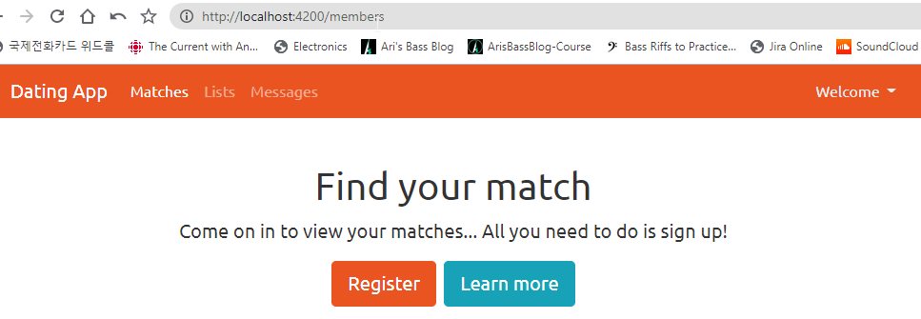
10. app.component.html
<app-nav></app-nav>
<router-outlet></router-outlet>
11. Test
(without login)
12. Test
(with login)

Slide 12
05 Building UI (such as member list and detail etc)
src\app>mkdir _models
Cd _models
Create photo.ts (under _models folder)
export interface Photo {
id: number;
url: string;
description: string;
dateAdded: Date;
isMain: boolean;
}
4. Create user.ts (under _models folder)
import { Photo } from './photo';
export interface User {
id: number;
username: string;
knownAs: string;
age: number;
created: Date;
lastActive: Date;
photoUrl: string;
city: string;
country: string;
interests?: string;
introduction?: string;
lookingFor?: string;
photos?: Photo[];
}
5. environment.ts (look at comment area)
export const environment = {
production: false,
apiUrl: 'http://localhost:5000/api/'
};
6. src\app\_services>ng g s user
(NOTE) Service is not “automatically” registered in app.module. You need to “manually” register
user.service.ts
import { Injectable } from '@angular/core';
import { environment } from '../../environments/environment';
import { HttpClient, HttpHeaders } from '@angular/common/http'; // note httpClient should be from HttpClient
import { Observable } from 'rxjs';
import { User } from '../_models/user';
// once JwtModule is defined in app.module, then it does not need to be set.
// It means it is automatically set
// set bearer token
// const httpOptions = {
// headers: new HttpHeaders({
// 'Authorization': 'Bearer ' + localStorage.getItem('token')
// })
// };
@Injectable({
providedIn: 'root'
})
export class UserService {
baseUrl = environment.apiUrl; // get data from environment.ts (it is also applied with auth.Service)
constructor(private http: HttpClient) {}
// return observable
getUsers(): Observable<User[]> {
return this.http.get<User[]>(this.baseUrl + 'users');// , httpOptions);
}
getUser(id:any): Observable<User> {
return this.http.get<User>(this.baseUrl + 'users/' + id); //, httpOptions);
}
}
App.module.ts
…
import { JwtModule } from '@auth0/angular-jwt’;
…
imports: [
JwtModule.forRoot({
config: {
tokenGetter: function tokenGetter() {
return localStorage.getItem('token');},
allowedDomains: ['localhost:5000'], //angular 11
disallowedRoutes:['localhost:5000/api/auth'] //angular 11
// NOTE: angular 9 and 10
// whitelistedDomains: ['localhost:3000'],
// blacklistedRoutes: ['http://localhost:3000/auth/login']
}
}),
BrowserModule,
…

Slide 13
auth.service.ts
…
import { environment } from '../../environments/environment’;
…
baseUrl = environment.apiUrl + 'auth/’;
…
9. member-list.component
import { Component, OnInit } from '@angular/core';
import { User } from '../../_models/user';
import { UserService } from '../../_services/user.service';
import { AlertifyService } from '../../_services/alertify.service';
import { ActivatedRoute } from '../../../../node_modules/@angular/router';
@Component({
selector: 'app-member-list',
templateUrl: './member-list.component.html',
styleUrls: ['./member-list.component.css']
})
export class MemberListComponent implements OnInit {
users!: User[]; // https://stackoverflow.com/questions/49699067/property-has-no-initializer-and-is-not-definitely-assigned-in-the-construc
constructor(private userService: UserService, private alertify: AlertifyService,private route: ActivatedRoute) { }
ngOnInit() {
// use resolve of route
this.route.data.subscribe(data => {
this.users = data['users'];
});
} // loadUsers() {
// this.userService.getUsers().subscribe((users: User[]) => {
// this.users = users;
// }, error => {
// this.alertify.error(error);
// });
// } }
10. \src\app\members>ng g c member-card
11. member-card.component.ts
import { Component, OnInit, Input } from '@angular/core';
import { User } from '../../_models/user';
@Component({
selector: 'app-member-card',
templateUrl: './member-card.component.html',
styleUrls: ['./member-card.component.css']
})
export class MemberCardComponent implements OnInit {
@Input() user!: User ; // member-list is parent, this component is child. Therefore we need to expose property
constructor() { }
ngOnInit() {
}
}
12. member-card.component.html
<div class="card mb-4">
<div class="card-img-wrapper">
<img class="card-img-top" src="{{user.photoUrl}}" alt="{{user.knownAs}}">
<!-- for animated buttons start -->
<ul class="list-inline member-icons animate text-center">
<li class="list-inline-item"><button class="btn btn-primary"
[routerLink]="['/members/', user.id]"><i class="fa fa-user"></i></button></li>
<li class="list-inline-item"><button class="btn btn-primary"><i class="fa fa-heart"></i></button></li>
<li class="list-inline-item"><button class="btn btn-primary"><i class="fa fa-envelope"></i></button></li>
</ul>
<!-- for animated buttons end -->
</div>
<div class="card-body p-1">
<h6 class="card-title text-center mb-1"><i class="fa fa-user"></i>
{{user.knownAs}}, {{user.age}}
</h6>
<p class="card-text text-muted text-center">{{user.city}}</p>
</div>
</div>
App-routing.module.ts will be changed.

Slide 14
13. member-card.component.css
/* zooming */
.card:hover img {
transform: scale(1.2, 1.2);
transition-duration: 500ms;
transition-timing-function: ease-out;
opacity: 0.7;
} .card img {
transform: scale(1.0, 1.0);
transition-duration: 500ms;
transition-timing-function: ease-out;
} /* animated */
.card-img-wrapper {
overflow: hidden;
position: relative;
} .member-icons {
position: absolute;
bottom: -30%;
left: 0;
right: 0;
margin-right: auto;
margin-left: auto;
opacity: 0; /* invisible */
} .card-img-wrapper:hover .member-icons {
bottom: 0;
opacity: 1; /* visible */
} /* slide effect */
.animate {
transition: all 0.3s ease-in-out;
}
14. member-list.component.html
<div class="container mt-5">
<div class="row">
<div *ngFor="let user of users" class="col-lg-2 col-md-3 col-sm-6">
<!-- child component by passing -->
<app-member-card [user]="user"></app-member-card>
</div>
</div>
</div>
15. style.css
/* You can add global styles to this file, and also import other style files */
@import '../node_modules/bootstrap/dist/css/bootstrap.min.css';
@import '../node_modules/font-awesome/css/font-awesome.min.css';
@import '../node_modules/alertifyjs/build/css/alertify.min.css';
@import '../node_modules/alertifyjs/build/css/themes/bootstrap.min.css';
@import '../node_modules/bootswatch/dist/united/bootstrap.min.css';
.tab-panel {
border: 1px solid #ddd;
padding: 10px;
border-radius: 4px;
}
.nav-tabs > li.open, .member-tabset > .nav-tabs > li:hover {
border-bottom: 4px solid #fbcdcf;
}
.member-tabset > .nav-tabs > li.open > a, .member-tabset > .nav-tabs > li:hover > a {
border: 0;
background: none !important;
color: #333333;
}
.member-tabset > .nav-tabs > li.open > a > i, .member-tabset > .nav-tabs > li:hover > a > i {
color: #a6a6a6;
}
.member-tabset > .nav-tabs > li.open .dropdown-menu, .member-tabset > .nav-tabs > li:hover .dropdown-menu {
margin-top: 0px;
}
.member-tabset > .nav-tabs > li.active {
border-bottom: 4px solid #E95420;
position: relative;
}
.member-tabset > .nav-tabs > li.active > a {
border: 0 !important;
color: #333333;
}
.member-tabset > .nav-tabs > li.active > a > i {
color: #404040;
}
.member-tabset > .tab-content {
margin-top: -3px;
background-color: #fff;
border: 0;
border-top: 1px solid #eee;
padding: 15px 0;
}

Slide 15
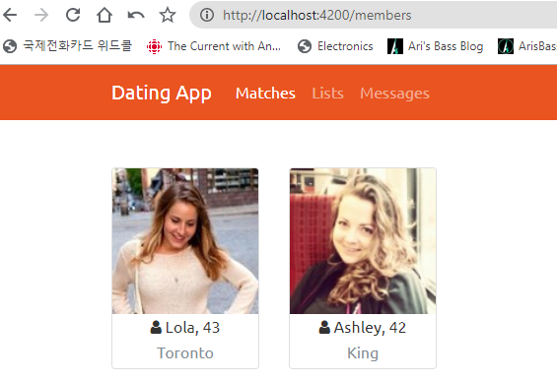
16. Route Resolver: BEFORE data is activated via route, it resolves data at first
17. \src\app>mkdir _resolvers
18. >cd _resolvers
19. src\app\_resolvers>ng g resolver member-list
20. member-list.resolver.ts
import {Injectable} from '@angular/core';
import {User} from '../_models/user';
import {Resolve, Router, ActivatedRouteSnapshot} from '@angular/router';
import { UserService } from '../_services/user.service';
import { AlertifyService } from '../_services/alertify.service';
import { Observable, of } from 'rxjs';
import { catchError } from 'rxjs/operators';
@Injectable()
export class MemberListResolver implements Resolve<User[]> {
constructor(private userService: UserService, private router: Router,
private alertify: AlertifyService) {}
resolve(route: ActivatedRouteSnapshot): Observable<User[]> {
return this.userService.getUsers().pipe(
catchError(error => {
this.alertify.error('Problem retrieving data');
this.router.navigate(['/home']);
return of([]); // https://blog.angular-university.io/rxjs-error-handling/
})
);
}
} 21. app.module.ts (always manually register except components)
…
import { MemberListResolver } from './_resolvers/member-list.resolver’;
…
providers: [
AuthService,
AlertifyService,
UserService,
MemberListResolver
],
22. app-routing.module.ts
…
import { MemberListResolver } from './_resolvers/member-list.resolver’;
…
children: [
{path: 'members', component: MemberListComponent,
resolve: {users: MemberListResolver}}, /* make data available BEFORE routing start work */
{path: 'messages', component: MessagesComponent},
{path: 'lists', component: ListsComponent},
]
…
23. Test
Not ready to see member detail yet. Only list
24. app/_resolvers>ng g r member-detail

Slide 16
25. app.module.ts
…
import { MemberDetailResolver } from './_resolvers/member-detail.resolver’;
…
providers: [
AuthService,
AlertifyService,
UserService,
MemberListResolver,
MemberDetailResolver
],
…
26. member-detail.resolvers.ts
import {Injectable} from '@angular/core';
import {User} from '../_models/user';
import {Resolve, Router, ActivatedRouteSnapshot} from '@angular/router';
import { UserService } from '../_services/user.service';
import { AlertifyService } from '../_services/alertify.service';
import { Observable, of } from 'rxjs';
import { catchError } from 'rxjs/operators';
// NOTE: BEFORE data is activated via route, it resolves data at first
// it needs to be registered at "route"
@Injectable()
export class MemberDetailResolver implements Resolve<User> {
constructor(private userService: UserService, private router: Router,
private alertify: AlertifyService) {}
resolve(route: ActivatedRouteSnapshot): Observable<User> {
// just return, do not subscribe here. Let each component to subscribe to it
return this.userService.getUser(route.params['id']).pipe(
catchError(error => {
this.alertify.error('Problem retrieving data');
this.router.navigate(['/members']);
let user: any = null;
return of(user); // https://blog.angular-university.io/rxjs-error-handling/
})
);
}
}
27. app-routing.module.ts
…
children: [
{path: 'members', component: MemberListComponent,
resolve: {users: MemberListResolver}}, /* make data available BEFORE routing start work */
{path: 'members/:id', component: MemberDetailComponent,
resolve: {user: MemberDetailResolver}}, // go to member-detail.resolve
{path: 'messages', component: MessagesComponent},
{path: 'lists', component: ListsComponent},
]
…
28. (NOTE) ngx-gallery: npm install ngx-gallery does not work, Instead
> npm install@kolvov/ngx-gallery
29. Along with ngx-gallery registration on app.module, register tab for ngx-bootstrap
App.module.ts
…
import { NgxGalleryModule } from '@kolkov/ngx-gallery';
import { TabsModule } from 'ngx-bootstrap/tabs’;
…
imports: [
…
BrowserModule,
AppRoutingModule,
HttpClientModule,
FormsModule,
BrowserAnimationsModule,
BsDropdownModule.forRoot(),
TabsModule.forRoot(),
NgxGalleryModule
],
…

Slide 17
30. app/members> ng g c member-detail
31. member-detail.components.ts
import { Component, OnInit } from '@angular/core';
import { User } from '../../_models/user';
import { UserService } from '../../_services/user.service';
import { AlertifyService } from '../../_services/alertify.service';
import { ActivatedRoute } from '@angular/router';
import { NgxGalleryOptions, NgxGalleryImage, NgxGalleryAnimation } from '@kolkov/ngx-gallery';
import { Photo } from '../../_models/photo';
// ref: https://github.com/kolkov/ngx-gallery
// NOTE: if you are using angular v9, try to use -->> npm install@kolvov/ngx-gallery
@Component({
selector: 'app-member-detail',
templateUrl: './member-detail.component.html',
styleUrls: ['./member-detail.component.css']
})
export class MemberDetailComponent implements OnInit {
user!: User; // ref: npmjs.com/package/ngx-gallery galleryOptions!: NgxGalleryOptions[];
galleryImages!: NgxGalleryImage[];
constructor(private userService: UserService, private alertify: AlertifyService,
private route: ActivatedRoute) { }
ngOnInit() { //this.loadUser();
// instead... // use "resolve" in route and use it as below
this.route.data.subscribe(data => {
this.user = data['user'];
}); this.galleryOptions = [
{
width: '500px',
height: '500px',
imagePercent: 100,
thumbnailsColumns: 4,
imageAnimation: NgxGalleryAnimation.Slide,
preview: false
}
];
this.galleryImages = this.getImages();
}
// NOTE: if we use this way, BEFORE getUser merthod get called, this page is loaded, which raise an issue : this.user object gets null. Therefore we will have to use above way: "RoutingResolve"
// + means change parameter (string) to integer
// loadUser(){
// this.userService.getUser(+this.route.snapshot.params['id']).subscribe(
// (user:User) =>{
// this.user = user;
// }, error =>{
// this.alertify.error(error);
// }
// );
// }
// https://stackoverflow.com/questions/54884488/how-can-i-solve-the-error-ts2532-object-is-possibly-undefined
getImages() {
const imageUrls = [];
const user = this.user.photos;
if (this.user != null && this.user.photos != null)
{
for (let i = 0; i < this.user.photos.length; i++) {
imageUrls.push({
small: this.user.photos[i].url,
medium: this.user.photos[i].url,
big: this.user.photos[i].url,
description: this.user.photos[i].description
});
}
}
console.log(imageUrls);
return imageUrls;
}
}

Slide 18
32. member-detail.components.html
<div class="container mt-4">
<div class="row">
<h1>{{user.knownAs}}'s Profile</h1>
</div>
<div class="row">
<div class="col-sm-4">
<div class="card">
<img class="card-img-top img-thumbnail" src="{{user.photoUrl}}" alt="{{user.knownAs}}">
<div class="card-body">
<div>
<strong>Location:</strong>
<p>{{user.city}}, {{user.country}}</p>
</div>
<div>
<strong>Age:</strong>
<p>{{user.age}}</p>
</div>
<div>
<strong>Last Active:</strong>
<p>{{user.lastActive}}</p>
</div>
<div>
<strong>Member Since:</strong>
<p>{{user.created}}</p>
</div>
</div>
<div class="card-footer">
<div class="btn-group d-flex">
<button class="btn btn-primary w-100">Like</button>
<button class="btn btn-success w-100">Message</button>
</div>
</div>
</div>
</div>
<div class="col-sm-8">
<!-- ngx bootstrap -->
<div class="tab-panel">
<tabset class="member-tabset">
<tab heading="About {{user.knownAs}}">
<h4>Description</h4>
<p>{{user.introduction}}</p>
<h4>Looking For</h4>
<p>{{user.lookingFor}}</p>
</tab>
<tab heading="Interests">
<h4>Interests</h4>
<p>{{user.interests}}</p>
</tab>
<tab heading="Photos">
<ngx-gallery [options]="galleryOptions" [images]="galleryImages" class="ngx-gallery"></ngx-gallery>
</tab>
<tab heading="Messages">
<p>Messages will go here</p>
</tab>
</tabset>
</div>
</div>
</div>
</div>
33. member-detail.components.css
.img-thumbnail {
margin: 25px;
width: 85%;
height: 85%;
} .card-body {
padding: 0 25px;
} .card-footer {
padding: 10px 15px;
background-color: #fff;
border-top: none;
}
.ngx-gallery { display: inline-block; margin-bottom: 20px; }

Slide 19
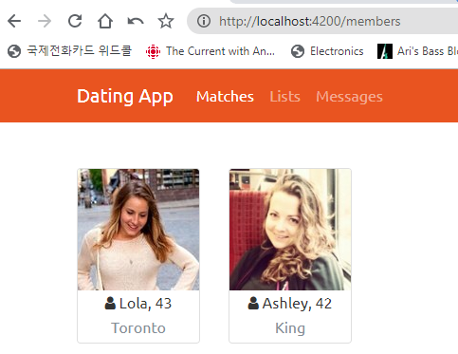
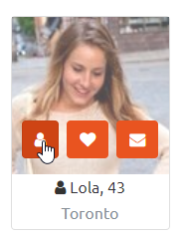
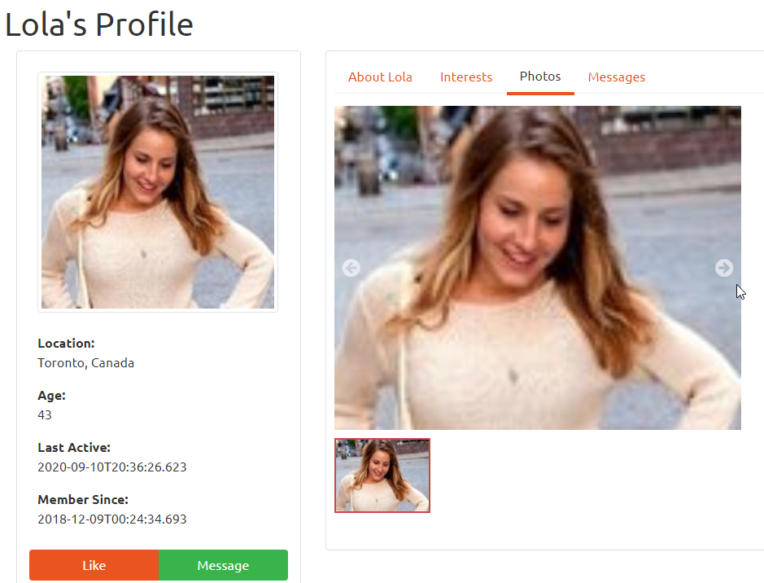
34. Styles.css
/* You can add global styles to this file, and also import other style files */
@import '../node_modules/bootstrap/dist/css/bootstrap.min.css';
@import '../node_modules/font-awesome/css/font-awesome.min.css';
@import '../node_modules/alertifyjs/build/css/alertify.min.css';
@import '../node_modules/alertifyjs/build/css/themes/bootstrap.min.css';
@import '../node_modules/bootswatch/dist/united/bootstrap.min.css';
.tab-panel {
border: 1px solid #ddd;
padding: 10px;
border-radius: 4px;
}
.nav-tabs > li.open, .member-tabset > .nav-tabs > li:hover {
border-bottom: 4px solid #fbcdcf;
}
.member-tabset > .nav-tabs > li.open > a, .member-tabset > .nav-tabs > li:hover > a {
border: 0;
background: none !important;
color: #333333;
}
.member-tabset > .nav-tabs > li.open > a > i, .member-tabset > .nav-tabs > li:hover > a > i {
color: #a6a6a6;
}
.member-tabset > .nav-tabs > li.open .dropdown-menu, .member-tabset > .nav-tabs > li:hover .dropdown-menu {
margin-top: 0px;
}
.member-tabset > .nav-tabs > li.active {
border-bottom: 4px solid #E95420;
position: relative;
}
.member-tabset > .nav-tabs > li.active > a {
border: 0 !important;
color: #333333;
}
.member-tabset > .nav-tabs > li.active > a > i {
color: #404040;
}
.member-tabset > .tab-content {
margin-top: -3px;
background-color: #fff;
border: 0;
border-top: 1px solid #eee;
padding: 15px 0;
}
35. Test

Slide 20
06 Updating Profile
1. src\app\members>ng g c member-edit
2. user.service.ts
…
updateUser(id: number, user: User) {
return this.http.put(this.baseUrl + 'users/' + id, user);
}
…
3. member-edit.component.ts
import { Component, OnInit, ViewChild, HostListener } from '@angular/core';
import { User } from '../../_models/user';
import { ActivatedRoute } from '@angular/router';
import { AlertifyService } from '../../_services/alertify.service';
import { NgForm } from '@angular/forms';
import { UserService } from '../../_services/user.service';
import { AuthService } from '../../_services/auth.service';
@Component({
selector: 'app-member-edit',
templateUrl: './member-edit.component.html',
styleUrls: ['./member-edit.component.css']
})
export class MemberEditComponent implements OnInit {
@ViewChild('editForm', { static: true }) editForm!: NgForm;
user!: User;
// NOTE: this is for the case when user close browser without saving data. Router cannot handle this special case.
@HostListener('window:beforeunload', ['$event'])
unloadNotification($event: any) {
if (this.editForm.dirty) {
$event.returnValue = true;
}
}
constructor(private route: ActivatedRoute, private alertify: AlertifyService,
private userService: UserService, private authService: AuthService) { }
ngOnInit() {
this.route.data.subscribe(data => {
this.user = data['user'];
});
}
updateUser() {
this.userService.updateUser(this.authService.decodedToken.nameid, this.user).subscribe(next => {
this.alertify.success('Profile updated successfully');
this.editForm.reset(this.user); // make form untouched, pristine. NOTE: reset the form value as they were saved. In order to that , pass parameter
}, error => {
this.alertify.error(error);
});
}
}
4. member-edit.component.html
<div class="container mt-4">
<div class="row">
<div class="col-sm-4">
<h1>Your Profile</h1>
</div>
<div class="col-sm-8">
<div *ngIf="editForm.dirty" class="alert alert-info">
<strong>Information:</strong> You have made changes. Any unsaved changes will be lost!
</div>
</div>
</div>
<div class="row">
<div class="col-sm-4">
<div class="card">
<img class="card-img-top img-thumbnail" src="{{user.photoUrl}}" alt="{{user.knownAs}}">
<div class="card-body">
<div>
<strong>Location:</strong>
<p>{{user.city}}, {{user.country}}</p>
</div>
<div>
<strong>Age:</strong>
<p>{{user.age}}</p>
</div>

Slide 21
<div>
<strong>Last Active:</strong>
<p>{{user.lastActive}}</p>
</div>
<div>
<strong>Member Since:</strong>
<p>{{user.created}}</p>
</div>
</div>
<div class="card-footer">
<!-- note form attribute -->
<button [disabled]="!editForm.dirty" form="editForm" class="btn btn-success btn-block">Save
Changes</button>
</div>
</div>
</div>
<div class="col-sm-8">
<div class="tab-panel">
<tabset class="member-tabset">
<tab heading="Edit Profile">
<!-- angular form template-->
<form #editForm="ngForm" id="editForm" (ngSubmit)="updateUser()">
<h4>Description</h4>
<textarea class="form-control" name="introduction" rows="6"
[(ngModel)]="user.introduction"></textarea>
<h4>Looking For</h4>
<textarea class="form-control" name="lookingFor" rows="6"
[(ngModel)]="user.lookingFor"></textarea>
<h4>Interests</h4>
<textarea class="form-control" name="interests" rows="6"
[(ngModel)]="user.interests"></textarea>
<h4>Location Details:</h4>
<div class="form-inline">
<label for="city">City</label>
<input type="text" class="form-control" name="city" [(ngModel)]="user.city">
<label for="country">City</label>
<input type="text" class="form-control" name="country" [(ngModel)]="user.country">
</div>
</form>
</tab>
<tab heading="Edit Photos">
<p>Photo edit will go here</p>
</tab>
</tabset>
</div>
</div>
</div>
</div>
5. \src\app\_resolvers>ng g r member-edit
import { Injectable } from '@angular/core';
import {
Router, Resolve,
RouterStateSnapshot,
ActivatedRouteSnapshot
} from '@angular/router';
import { Observable, of } from 'rxjs';
import { catchError } from 'rxjs/operators';
import { User } from '../_models/user';
import { AlertifyService } from '../_services/alertify.service';
import { AuthService } from '../_services/auth.service';
import { UserService } from '../_services/user.service';
@Injectable({
providedIn: 'root'
})
export class MemberEditResolver implements Resolve<User> {
constructor(private userService: UserService, private router: Router,
private alertify: AlertifyService, private authService: AuthService) {}
resolve(route: ActivatedRouteSnapshot): Observable<User> {
return this.userService.getUser(this.authService.decodedToken.nameid).pipe(
catchError(error => {
this.alertify.error('Problem retrieving your data');
this.router.navigate(['/members']);
let user: any = null;
return of(user);
})
);
}
}
6. app.module.ts
…
import { MemberEditResolver } from './_resolvers/member-edit.resolver’;
…
providers: [
AuthService,
AlertifyService,
UserService,
MemberListResolver,
MemberDetailResolver,
MemberEditResolver
],

Slide 22
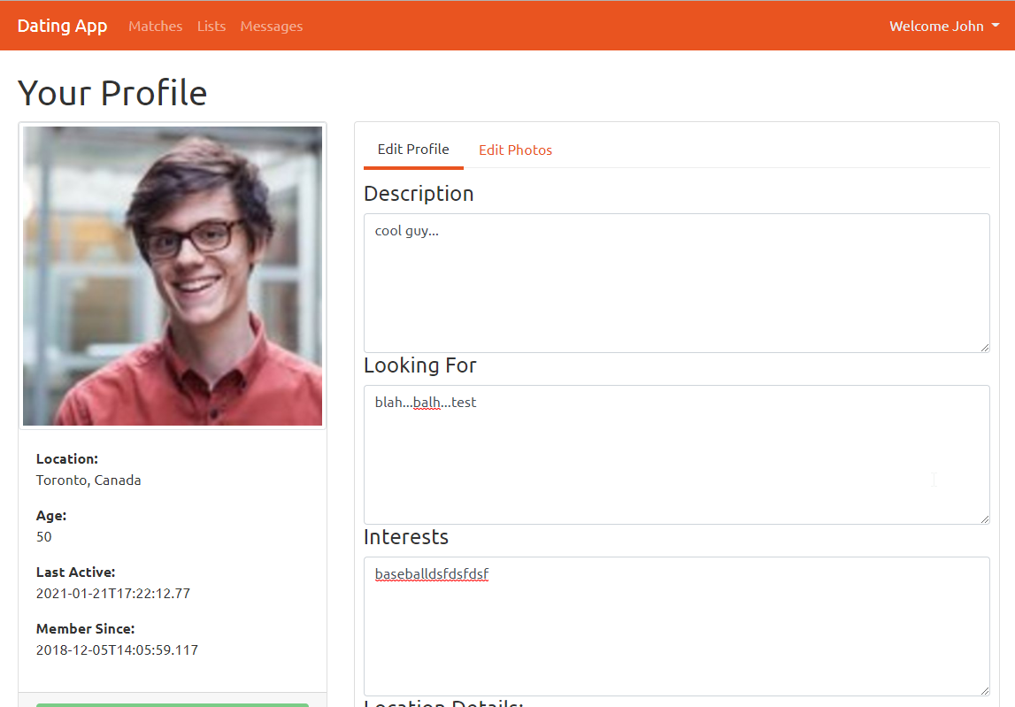
7. \src\app\_guards>ng g guard prevent-unsaved-changes
? Which interfaces would you like to implement? CanDeactivate
CREATE src/app/_guards/prevent-unsaved-changes.guard.spec.ts (418 bytes)
CREATE src/app/_guards/prevent-unsaved-changes.guard.ts (564 bytes)
import { Injectable } from '@angular/core';
import { CanDeactivate, ActivatedRouteSnapshot, RouterStateSnapshot, UrlTree } from '@angular/router';
import { Observable } from 'rxjs';
import { MemberEditComponent } from '../members/member-edit/member-edit.component';
@Injectable({
providedIn: 'root'
})
export class PreventUnsavedChanges implements CanDeactivate<MemberEditComponent> {
canDeactivate(component: MemberEditComponent) {
if (component.editForm.dirty) {
return confirm('Are you sure you want to continue? Any unsaved changes will be lost');
}
return true;
}
}
8. app.module.ts
…
import { PreventUnsavedChanges } from './_guards/prevent-unsaved-changes.guard’;
…
providers: [
AuthService,
AlertifyService,
UserService,
MemberListResolver,
MemberDetailResolver,
MemberEditResolver,
PreventUnsavedChanges
],
9. app.routing.module.ts
children: [
{path: 'members', component: MemberListComponent,
resolve: {users: MemberListResolver}}, /* make data available BEFORE routing start work */
{path: 'members/:id', component: MemberDetailComponent,
resolve: {user: MemberDetailResolver}}, // go to member-detail.resolve
{path: 'member/edit', component: MemberEditComponent,
resolve: {user: MemberEditResolver}, canDeactivate: [PreventUnsavedChanges]},
{path: 'messages', component: MessagesComponent},
{path: 'lists', component: ListsComponent},
]
10. nav.component.html
…
<div class="dropdown-menu mt-3" *dropdownMenu>
<a class="dropdown-item" [routerLink]="['/member/edit']">
<i class="fa fa-user"></i> Edit Profile</a>
<div class="dropdown-divider"></div>
<a class="dropdown-item" (click)="logout()">
<i class="fa fa-sign-out"></i> Logout</a>
</div>
…
11. Test

Slide 23
07 Photo Upload

